Slide 1
Workout App - GetFit
Andrew Long, Andrew Toufas, Gian Santos, Joseph Rocaberte

Slide 2
Components Used
Database, DBHelper
Fragments
Custom adapter for fragments
Links to Youtube
Workout Class and Adapter
List View

Slide 3
Database
Used to store workout information
Contains name of workouts, targeted muscle groups, image id, and youtube url
Implemented query method into DBHelper that allows us to specifically choose what tuples we want to display from DB using SQL.

Slide 4
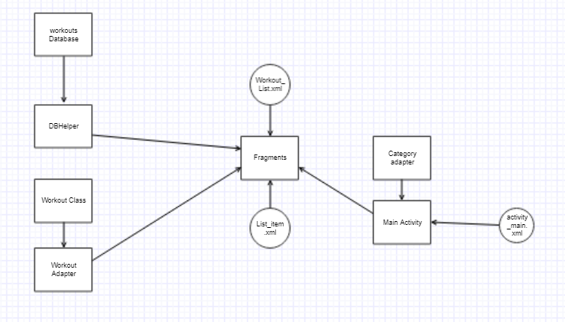
Structure

